Slide 1
Business Process Engineering (BPE)

Slide 2
Outline
Core concepts and their descriptions

Slide 3
Process vs Project
The defining characteristic of process vs. project is repeatability vs. uniqueness.
Process is a repetitive collection of interrelated tasks aimed at achieving a certain goal.
Project is a unique endeavour with a beginning and an end undertaken to achieve a goal.

Slide 4
Core Concepts
BPM addresses end-to-end work and distinguishes between sets of subprocesses, tasks, activities and functions
BPM requires a significant organisational commitment, often introducing new roles, responsibilities and structures to traditional functionally oriented organisations
BPM is technology enabled with tools for visual modelling, simulation, automation, integration, control and monitoring of business processes and the information systems which support these processes

Slide 5
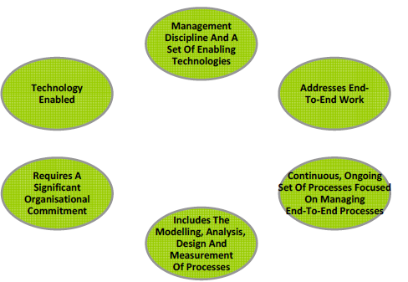
Core Concepts

Slide 6
(1) Management Discipline and Enabling Technologies
Enabling technology is meaningless without the management disciplines and processes for exploiting the technology
Vendors have created application suites which help enable organisations to better manage their business processes
  Tools to visually design and model business processes
  Simulate and test business processes, automate, control and measure business processes
  Provide feedback and reporting on process performance
  Some vendors have combined these into integrated business process management suites

Slide 7
Management Discipline and Enabling Technologies
Most large organisations have a significant investment into a number of legacy systems:
  Designed to support specific functions
  A BPMS must be able to integrate with legacy systems in order to control work, get information or measure performance
  Common framework for how these technologies are deployed is most often referred to as a Service Oriented Architecture (SOA)

Slide 8
(2) Addresses End-To-End Work
Business functions are typically defined by a group of activities related by a particular skill or goal such (i.e. sales, finance, manufacturing)
Business processes focus on the end-to-end work, i.e., tasks and activities, across functional boundaries to deliver customer value
Business processes have defined inputs and outputs and functions have not

Slide 9
(3) Ongoing Management of Processes
BPM involves a permanent ongoing organisational commitment to managing the organisations processes
Includes:
  Modelling
  Analysis
  Process design
  Performance measurement

Slide 10
(4) Modelling, Analysis, Design and Measurement of Processes
Practice of BPM requires the measurement and supervision of process performance
  Setting process performance goals
  Measuring actual performance, the efficiency of the business processes (“doing the thing right“)
  Reviewing the effectiveness of business processes (“doing the right thing“)
  Providing information, insight and feedback to other primary activities such as process analysis, design and transformation
Gather information at key points in the process to support decisions regarding cost or timing

Slide 11
(5) Organisational Commitment
Management of end-to-end business process crosses organisational boundaries
New roles and responsibilities are introduced, such as process owners, designers and architects
Individuals responsible for end-to-end process design must interact with traditional functionally based managers
New governance structures need to be introduced which may change the way organisations make decisions and allocate resources
Practice of BPM requires a significant organisational commitment: without organisational commitment, the practice and benefits of BPM is unlikely to mature within an organisation
Without supporting leadership, values, beliefs and culture, BPM is unlikely to successfully take hold within an organisation

Slide 12
(6) BPM Technology
BPM is a technology enabled and supported management discipline
Wide range of technologies available to support the planning, design, analysis, operation and monitoring of business processes
Application suites available which help enable organisations to better manage their business processes
BPM systems must be able to integrate with legacy systems in order to control work and get information or measure performance
Common framework for how these technologies are deployed is most often referred to as a Service Oriented Architecture (SOA)

Slide 13
End of Lecture

